Slide 1
Transaction Manager
A transaction manager is a part of an application that controls the coordination of transactions over one or more resources.
The transaction manager is responsible for creating transaction objects and managing their durability and atomicity.
Notes:
‹#›

Slide 2
Outline
Transaction Concept
Transaction State
Notes:
‹#›

Slide 3
Transaction Concept
A transaction is a unit of program execution that accesses and possibly updates various data items.
E.g., transaction to transfer $50 from account A to account B:
1. read(A)
2. A := A – 50
3. write(A)
4. read(B)
5. B := B + 50
6. write(B)
Two main issues to deal with:
Failures of various kinds, such as hardware failures and system crashes
Concurrent execution of multiple transactions
Notes:
‹#›

Slide 4
Required Properties of a Transaction
Transaction to transfer $50 from account A to account B:
1. read(A)
2. A := A – 50
3. write(A)
4. read(B)
5. B := B + 50
6. write(B)
Atomicity requirement
If the transaction fails after step 3 and before step 6, money will be “lost” leading to an inconsistent database state
Failure could be due to software or hardware
The system should ensure that updates of a partially executed transaction are not reflected in the database
Durability requirement — once the user has been notified that the transaction has completed (i.e., the transfer of the $50 has taken place), the updates to the database by the transaction must persist even if there are software or hardware failures.
Notes:
‹#›

Slide 5
Required Properties of a Transaction (Cont.)
Consistency requirement in above example:
The sum of A and B is unchanged by the execution of the transaction
In general, consistency requirements include
Explicitly specified integrity constraints such as primary keys and foreign keys
Implicit integrity constraints
e.g., sum of balances of all accounts, minus sum of loan amounts must equal value of cash-in-hand
A transaction, when starting to execute, must see a consistent database.
During transaction execution the database may be temporarily inconsistent.
When the transaction completes successfully the database must be consistent
Erroneous transaction logic can lead to inconsistency
Notes:
‹#›

Slide 6
Required Properties of a Transaction (Cont.)
Isolation requirement — if between steps 3 and 6 (of the fund transfer transaction) , another transaction T2 is allowed to access the partially updated database, it will see an inconsistent database (the sum A + B will be less than it should be).
T1 T2
1. read(A)
2. A := A – 50
3. write(A) read(A), read(B), print(A+B)
4. read(B)
5. B := B + 50
6. write(B
Isolation can be ensured trivially by running transactions serially
That is, one after the other.
However, executing multiple transactions concurrently has significant benefits, as we will see later.
Notes:
‹#›

Slide 7
ACID Properties
A transaction is a unit of program execution that accesses and possibly updates various data items. To preserve the integrity of data the database system must ensure:
Atomicity. Either all operations of the transaction are properly reflected in the database or none are.
Consistency. Execution of a transaction in isolation preserves the consistency of the database.
Isolation. Although multiple transactions may execute concurrently, each transaction must be unaware of other concurrently executing transactions. Intermediate transaction results must be hidden from other concurrently executed transactions.
That is, for every pair of transactions T_{i} and T_{j}, it appears to T_{i} that either T_{j}, finished execution before T_{i} started, or T_{j} started execution after T_{i} finished.
Durability. After a transaction completes successfully, the changes it has made to the database persist, even if there are system failures.
Notes:
‹#›

Slide 8
Transaction State
Active – the initial state; the transaction stays in this state while it is executing
Partially committed – after the final statement has been executed.
Failed -- after the discovery that normal execution can no longer proceed.
Aborted – after the transaction has been rolled back and the database restored to its state prior to the start of the transaction. Two options after it has been aborted:
Restart the transaction
can be done only if no internal logical error
Kill the transaction
Committed – after successful completion.
Notes:
‹#›

Slide 9
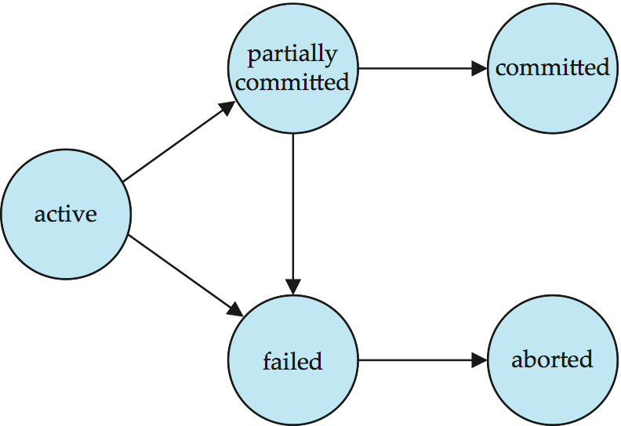
Transaction State (Cont.)
Notes:
‹#›

Slide 10
Schedules
Schedule – a sequences of instructions that specify the chronological order in which instructions of concurrent transactions are executed
A schedule for a set of transactions must consist of all instructions of those transactions
Must preserve the order in which the instructions appear in each individual transaction.
A transaction that successfully completes its execution will have a commit instructions as the last statement
By default transaction assumed to execute commit instruction as its last step
A transaction that fails to successfully complete its execution will have an abort instruction as the last statement
Notes:
‹#›

Slide 11
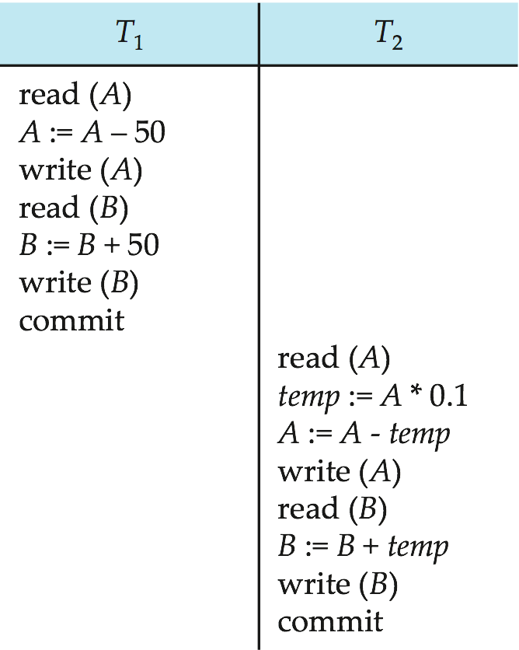
Schedule 1
Let T₁ transfer $50 from A to B, and T₂ transfer 10% of the balance from A to B.
An example of a serial schedule in which T₁ is followed by T₂ :
Notes:
‹#›

Slide 12
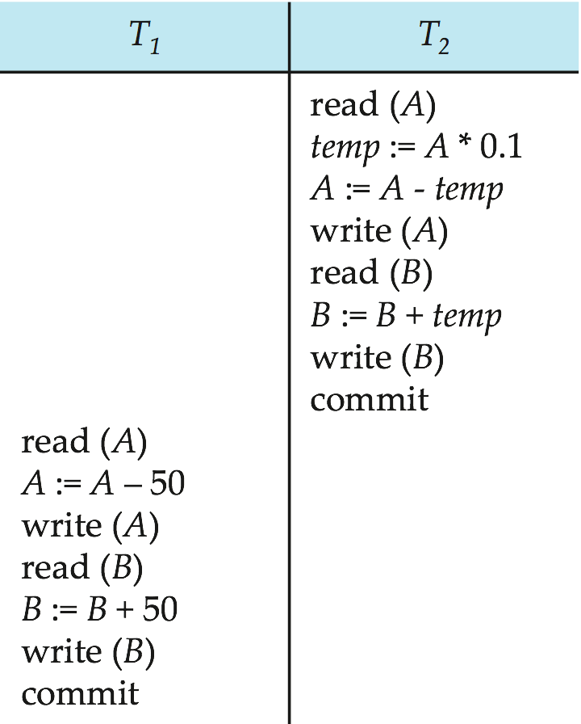
Schedule 2
A serial schedule in which T₂ is followed by T₁ :
Notes:
‹#›

Slide 13
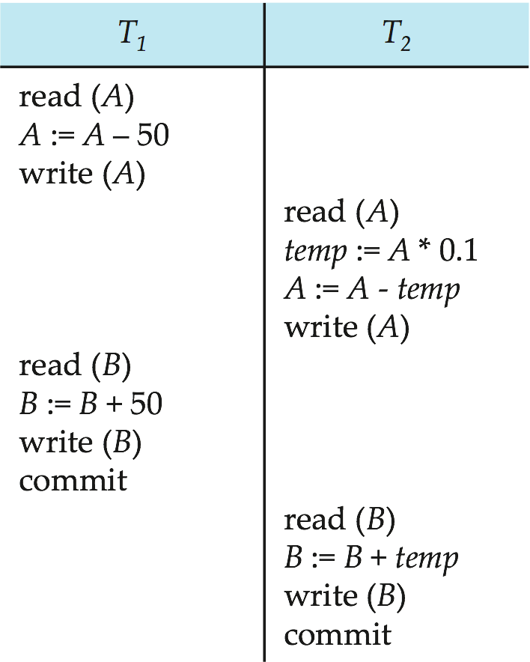
Schedule 3
Let T₁ and T₂ be the transactions defined previously. The following schedule is not a serial schedule, but it is equivalent to Schedule 1.
Note -- In schedules 1, 2 and 3, the sum “A + B” is preserved.
Notes:
‹#›

Slide 14
Recovery and Atomicity
To ensure atomicity despite failures, we first output information describing the modifications to stable storage without modifying the database itself.
We study log-based recovery mechanisms in detail
We first present key concepts
And then present the actual recovery algorithm
Notes:
‹#›

Slide 15
Log-Based Recovery
A log is kept on stable storage.
The log is a sequence of log records, which maintains information about update activities on the database.
When transaction T_{i} starts, it registers itself by writing a record <T_{i} start>
to the log
Before T_{i} executes write(X), a log record <T_{i}, X, V₁, V₂> is written, where V₁ is the value of X before the write (the old value), and V₂ is the value to be written to X (the new value).
When T_{i} finishes it last statement, the log record <T_{i} commit> is written.
Two approaches using logs
Immediate database modification
Deferred database modification
Notes:
‹#›

Slide 16
Transaction Commit
A transaction is said to have committed when its commit log record is output to stable storage
All previous log records of the transaction must have been output already
Writes performed by a transaction may still be in the buffer when the transaction commits, and may be output later
CP-5
Write log records for these two transactions for initial values of A and B are 2000 and 1000 respectively
When transaction T_{i} starts, it registers itself by writing a record <T_{i} start>
to the log
Before T_{i} executes write(X), a log record <T_{i}, X, V₁, V₂>

Slide 17
Immediate Database Modification Example
Log Write Output
<T₀ start>
<T₀, A, 1000, 950>
<T_{o}, B, 2000, 2050>
A = 950
B = 2050
<T₀ commit>
<T₁ start>
<T₁, C, 700, 600>
C = 600
B_{B} , B_{C}
<T₁ commit>
B_{A}
Note: B_{X} denotes block containing X.
B_{C} output before T₁ commits
B_{A} output after T₀ commits
Notes:
‹#›

Slide 18
Undo and Redo Operations
Undo of a log record <T_{i}, X, V₁, V₂> writes the old value V₁ to X
Redo of a log record <T_{i}, X, V₁, V₂> writes the new value V₂ to X
Undo and Redo of Transactions
undo(T_{i}) restores the value of all data items updated by T_{i} to their old values, going backwards from the last log record for T_{i}
Each time a data item X is restored to its old value V a special log record (called redo-only) <T_{i} , X, V> is written out
When undo of a transaction is complete, a log record <T_{i} abort> is written out (to indicate that the undo was completed)
redo(T_{i}) sets the value of all data items updated by T_{i} to the new values, going forward from the first log record for T_{i}
No logging is done in this case

Slide 19
Undo and Redo on Recovering from Failure
When recovering after failure:
Transaction T_{i} needs to be undone if the log
contains the record <T_{i} start>,
but does not contain either the record <T_{i} commit> or <T_{i} abort>.
Transaction T_{i} needs to be redone if the log
contains the records <T_{i} start>
and contains the record <T_{i} commit> or <T_{i} abort>
Notes:
‹#›

Slide 20
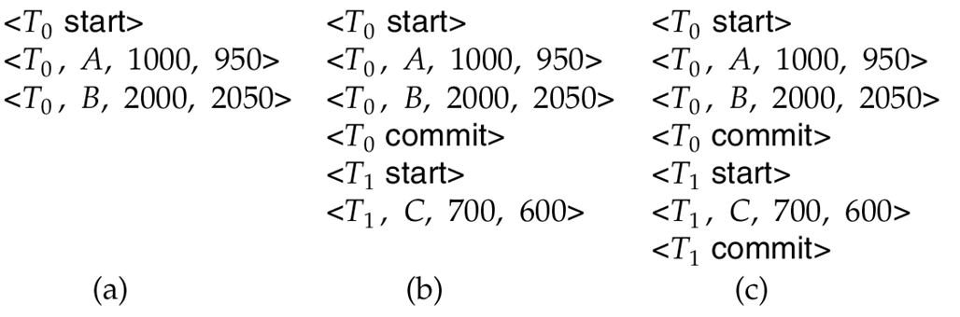
Immediate Modification Recovery Example
Below we show the log as it appears at three instances of time.
Recovery actions in each case above are:
(a) undo (T₀): B is restored to 2000 and A to 1000, and log records <T₀, B, 2000>, <T₀, A, 1000>, <T₀, abort> are written out
(b) redo (T₀) and undo (T₁): A and B are set to 950 and 2050 and C is restored to 700. Log records <T₁, C, 700>, <T₁, abort> are written out.
(c) redo (T₀) and redo (T₁): A and B are set to 950 and 2050
respectively. Then C is set to 600
Notes:
‹#›

Slide 21
Checkpoints
Redoing/undoing all transactions recorded in the log can be very slow
Processing the entire log is time-consuming if the system has run for a long time
We might unnecessarily redo transactions which have already output their updates to the database.
Streamline recovery procedure by periodically performing checkpointing
All updates are stopped while doing checkpointing
Output all log records currently residing in main memory onto stable storage.
Output all modified buffer blocks to the disk.
Write a log record < checkpoint L> onto stable storage where L is a list of all transactions active at the time of checkpoint.
Notes:
‹#›

Slide 22
Example of Checkpoints
T_{c}
T_{f}
T₁ can be ignored (updates already output to disk due to checkpoint)
T₂ and T₃ redone.
T₄ undone
T₁
T₂
T₃
T₄
checkpoint
system failure
Notes:
‹#›

Slide 23
Schedule 1
Let T₁ transfer $50 from A to B, and T₂ transfer 10% of the balance from A to B.
An example of a serial schedule in which T₁ is followed by T₂ :
Notes:
‹#›

